Slide 1
NEHRU JYOTI YOGA COLLEGE
Applied for PGDYT
VPO-Natata, Tehsil-Jamwaramgarh, Distt-Jaipur-302028

Slide 2
About Nehru Jyoti Yoga College
Nehru Jyoti Pubic Sansthan is a non-profit organisation founded in 2009. The organisation is established a new Institute "Nehru Jyoti Yoga College" at Natata near district head quarter of Jaipur.

Slide 3
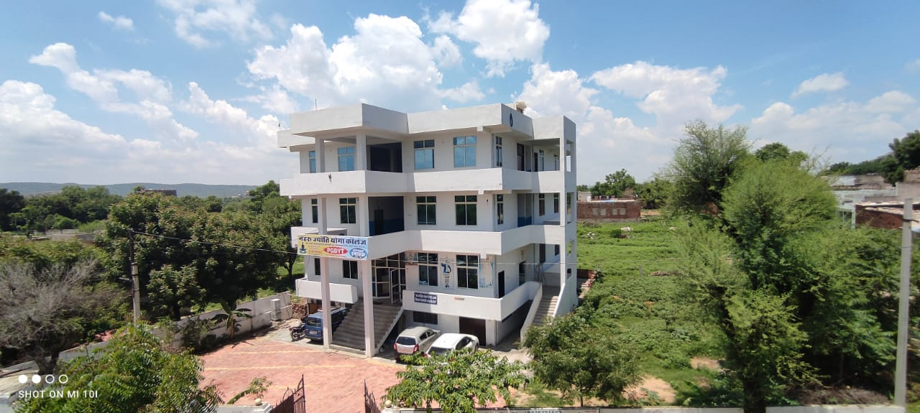
College Building

Slide 4
Land details
Sr. No. | Particular | Size in Sq. Mtr
1 | Total land area | 341.07
2 | Covered area | 230.00
3 | Class Room-1 | 27.69
4 | Class Room-2 | 27.59
5 | Seminar Hall | 107.16
6 | Library | 38.50
7 | Playground | 100.00
8 | Computer Lab | 27.54
9 | Yoga Hall-1 | 125.59

Slide 5
Type of Land-Leased Deed
Khasra No-124
Date of Occupation -23.09.2019
Owner Name-Nehru Jyoti Public Sansthan, Natata
Duration of Lease Deed-10 Years

Slide 6
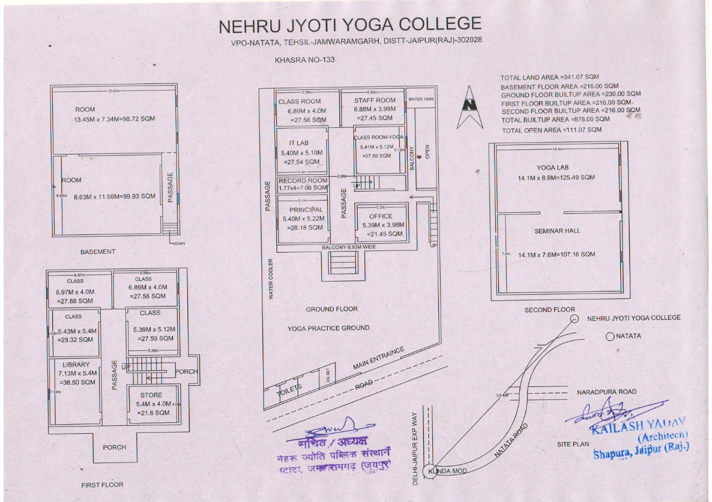
Building Map

Slide 7
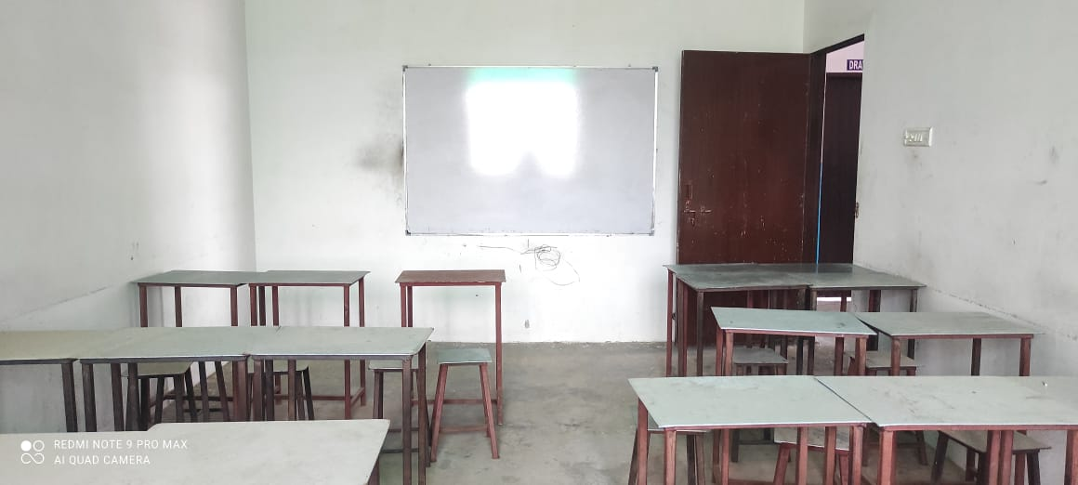
Class Room

Slide 8
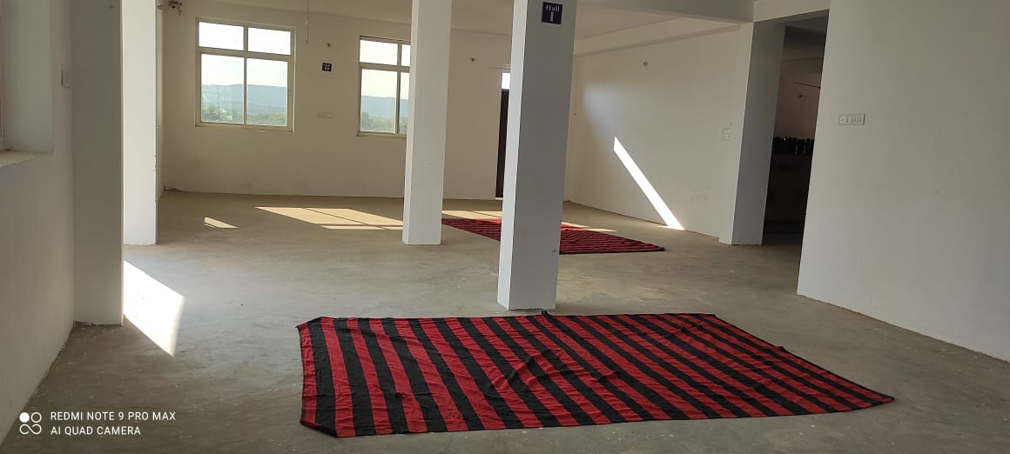
Yoga Hall

Slide 9
Library
Area=560 Sq Ft.

Slide 10
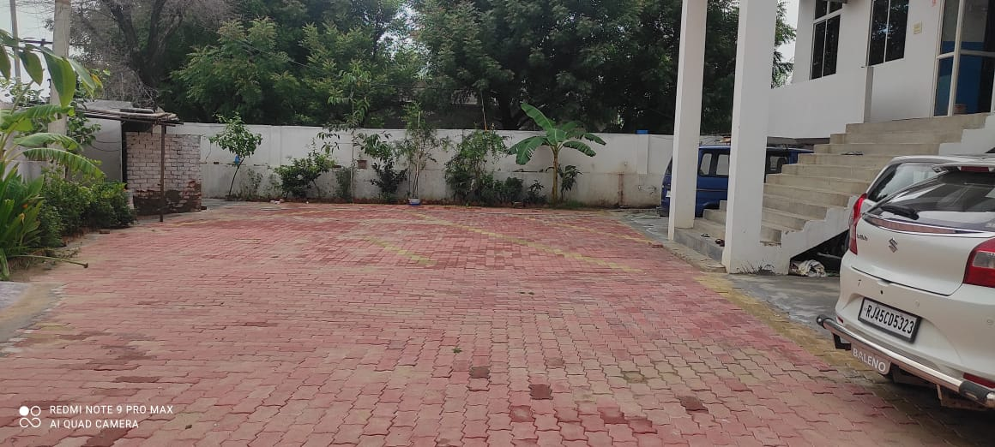
Playground/Yoga Practice

Slide 11
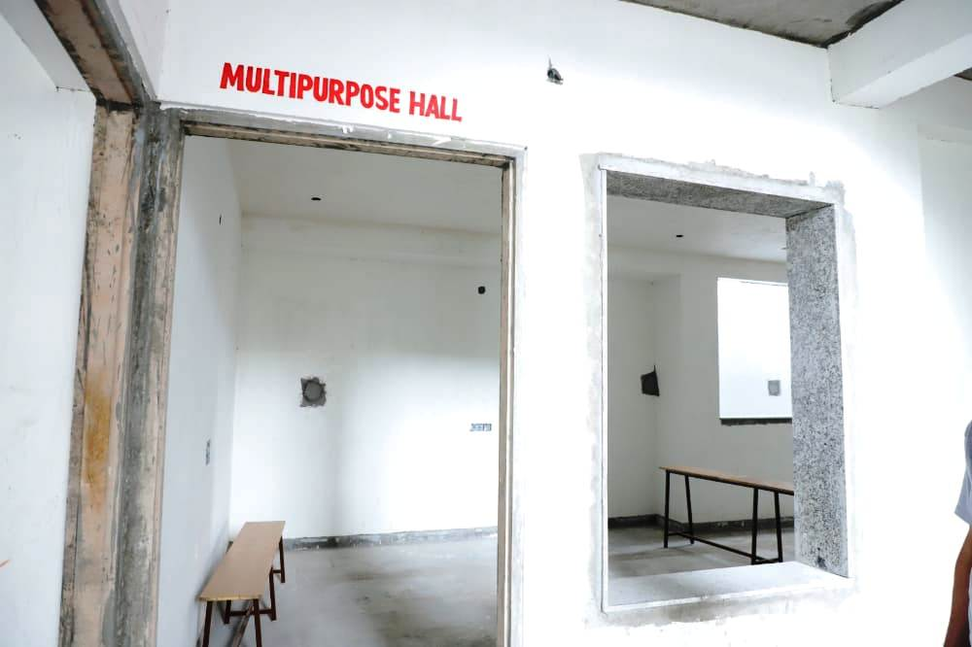
Multipurpose Hall

Slide 12
Staff Details
Sr. No | Name & Designation | Academic Qualification | Experience | Wheter Full Time/Part Time
1 | Komal Rao (Yoga Teacher) | PG Diploma in Yoga Science | 1 Year | Full Time
2
3
4
5

Slide 13
Website
http://www.nehrujyotiyogacollege.com

